Slide 1


Optimization2 of Stem Pairing
Week 9 Hua Jiang

Slide 2
Two main flaws of the algorithm logic:
Another type of false pairing
2. Flaws in small score strategy

Slide 3

1. Another type of false pairing
Last week: Solve Rhombus segmentations problem
(1) filter out small segmentation when pixels < 100
(2) Add filter on the pairing strategy:
Stem A as base stem, if Stem B is its best candidates with lowest score b, we must check, for Stem B as the base stem, if Stem A score a is not much different from Stem B score b.
If abs(a - b) > 30, this is a false pairing. Then Stem A has to move to the second best candidate and iterately check the if the filter condition is satisfied

Slide 4


1. Another type of false pairing
Critic: abs(a - b) < 30
Base Stem
Not Picked by the best candidate with a score 9
Second best candidate
Picked by the second best candidate with the score 75
Partner

Slide 5
1. Another type of false pairing
Fallback to pick the fisrst candidate
Not Picked by the best candidate with score 9
Add a fallback strategy:
If abs(a - b) < 30 fails and the second (or so on) candidate is picked, a_current should not be larger than a_previous (for all previous candidate).
If all later candidates fail this critic, fallback and pick the candidate (with lowest a + b)
Here Stem A score of all latter candidates > 9

Slide 6

1. Another type of false pairing
Add a fallback strategy:
If abs(a - b) < 30 fails and the second (or so on) candidate is picked, a_current should not be larger than a_previous (for all previous candidate).
If all later candidates fail this critic, fallback and pick the candidate (with lowest a + b)

Slide 7
Candidate scores
2. Flaws in small score strategy Algorithm
If
Else
Last Week:
If the candiates’ score is less than 3, just compare the distance
(2) If the score is 3 – 11, compare the score * distance
(3) Else, compare the score
Check candidates with score <3
If
Previously this part is missed
No
Else
Check candidates with 3< score <11
No
Yes
Yes
Check candidates with 11< score
Yes
Output

Slide 8
Candidate scores
2. Flaws in small score strategy Algorithm
If
Else
Else
Last Week:
If the candiate score is less than 3, just compare the distance
(2) If the score is 3 – 11, compare the score * distance
(3) Else, compare the score
If
Check candidates with score <3
Check candidates with 3< score <11
No
No
Check candidates with 11< score
Yes
Yes
Yes
Output

Slide 9
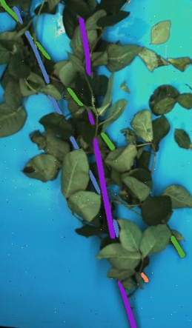

2. Flaws in small score strategy Algorithm
Base Stem
Partener
Best candidate

Slide 10
Future Work:
Optimization3

